Slide 1
UCI DATA ANALYTICS FOR BUSINESS
NETFLIX
Netflix Customer
Retention & Growth
Strategy
DATA
STRATEGY
Using customer engagement data to reduce churn, identify upgrade opportunities, and guide future acquisition.
Retention
Upgrade
Acquisition
Noah Poremba
Shohei Senda
Dataset
https://www.kaggle.com/datasets/abdulwadood11220/netflix-customer-churn-dataset
CAPSTONE PRESENTATION
2026

Slide 2
DATA STRATEGY ROADMAP
Our Netflix strategy follows CRISP-DM
Each phase moves the project from a business problem to practical customer-growth actions.
1
2
3
4
5
6
Business
Understanding
Data
Understanding
Data
Preparation
Modeling
Evaluation
Deployment
Retain, upgrade,
and acquire
Analyze 5,000
subscribers
Clean data and
engineer features
Predict customer
churn risk
Select the final
model
Campaigns
THE PLAN
THE ANALYSIS
THE REPORT
Define the business need, understand the customer data, and prepare it for analysis.
Use descriptive, diagnostic, predictive, and prescriptive analytics.
Tell the story and monitor action.
Netflix Customer Retention and Growth Strategy
2

Slide 3
BUSINESS UNDERSTANDING
Customer churn threatens
recurring revenue and growth
NETFLIX
THE
BUSINESS
PROBLEM
Streaming competition creates pressure to retain subscribers while expanding customer value.
01
Constant competitive pressure
Subscribers can choose among many streaming services and may switch when another platform appears more valuable.
Competition
Churn
Growth
02
Cancellations reduce revenue
When a customer churns, Netflix loses recurring monthly revenue and may spend more to replace that subscriber.
03
Data must guide growth actions
Customer data can help identify churn risk and highlight retention and membership-upgrade opportunities.
NETFLIX CUSTOMER RETENTION & GROWTH STRATEGY
3

Slide 4
BUSINESS UNDERSTANDING
Three objectives guide the analysis
Customer subscription and engagement data translate the business problem into measurable questions.
01
02
03
RETAIN
CUSTOMERS
GROW
MEMBERSHIP
ACQUIRE
HIGH-VALUE
OBJECTIVE
OBJECTIVE
OBJECTIVE
Predict churn risk and identify the behaviors connected to cancellation.
Identify Basic and Standard subscribers with the strongest upgrade potential.
Describe retained, high-value customers to guide future targeting.
KEY QUESTION
KEY QUESTION
KEY QUESTION
Which customer traits and engagement behaviors are associated with churn?
Which current subscribers appear to be the strongest upgrade opportunities?
What characteristics should inform future acquisition targeting?
Netflix Customer Retention and Growth Strategy
4

Slide 5
DATA UNDERSTANDING
The data behind the churn strategy
A synthetic Netflix-like dataset connects customer attributes and viewing behavior to subscription outcomes.
WHAT THE DATA CAPTURES
DATA PROFILE
5,000
01
Customer demographics
Customer ID, age, gender, and region.
synthetic customer records
02
Subscription information
UNIT OF ANALYSIS
Plan type, monthly fee, payment method, and number of profiles.
One row = one subscriber
TARGET: CHURNED
1 = canceled • 0 = retained
03
Customer engagement
Watch hours, average watch time, last login, device, and favorite genre.
Netflix Customer Retention and Growth Strategy
5

Slide 6
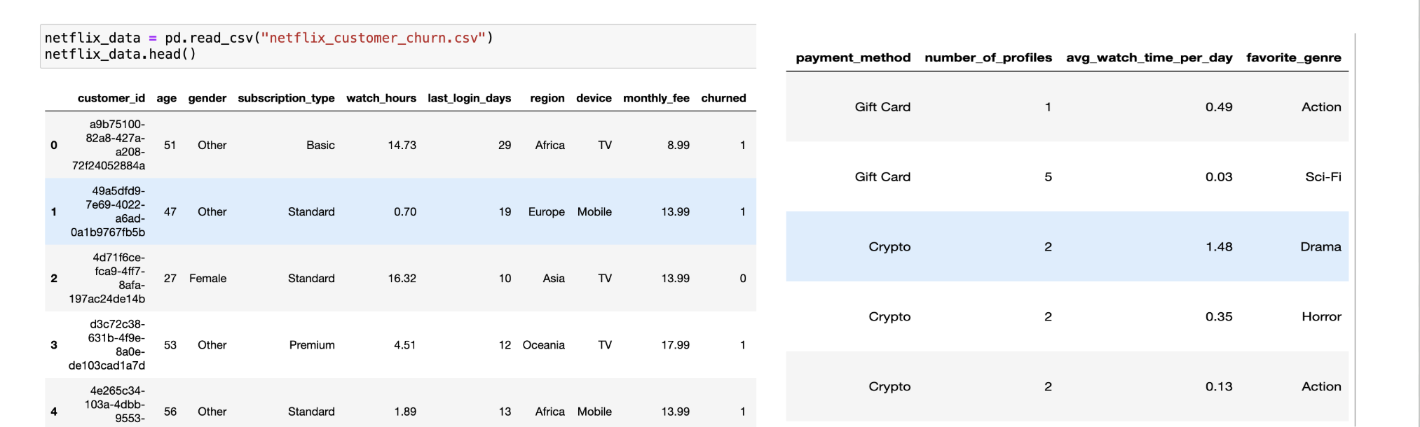
DATA PREPARATION
Initial customer-data review in Python
The notebook loads the CSV and previews the first five customer records before quality checks and feature engineering.
SOURCE VIEW: PYTHON NOTEBOOK DATA PREVIEW
INITIAL CHECK
DATA STRUCTURE
NEXT STEP
Load CSV and inspect first five records.
5,000 customers and 14 features.
Clean invalid values and engineer features.
Netflix Customer Retention and Growth Strategy
6

Slide 7
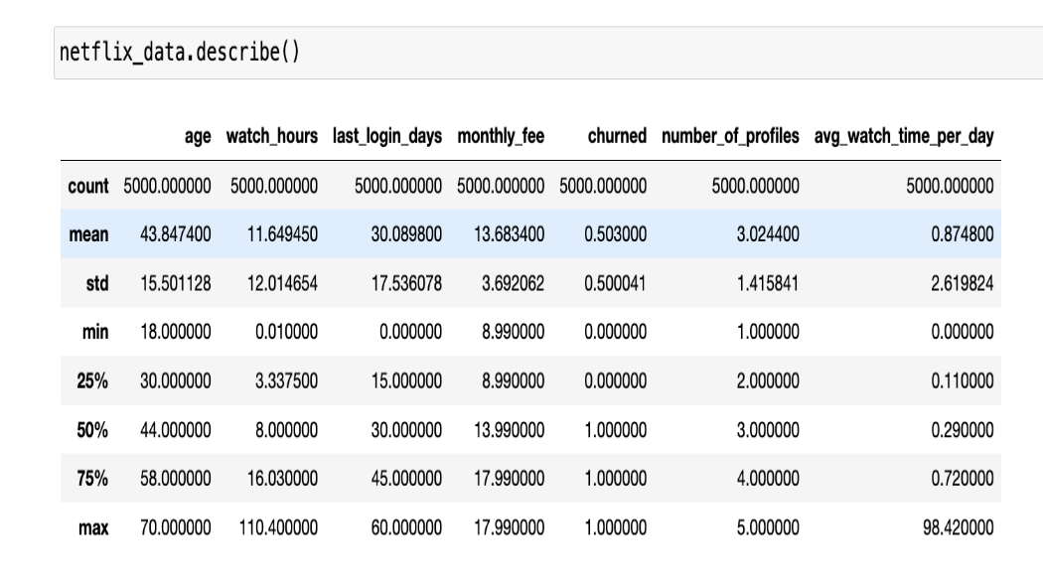
DATA PREPARATION • QUALITY CHECK
Summary statistics reveal what needs cleaning
Python summary statistics establish typical customer behavior and flag invalid values before predictive modeling.
WHAT THE SUMMARY SHOWS
TYPICAL CUSTOMER
Median age: 44
Median last login: 30 days
CHURN DISTRIBUTION
50.3% of records are labeled churned — a nearly balanced target.
DATA QUALITY FLAG
The maximum average watch time is 98.42 hours/day — an impossible value. Records above 24 hours/day were removed.
SOURCE VIEW: PYTHON SUMMARY STATISTICS
Netflix Customer Retention and Growth Strategy
7

Slide 8
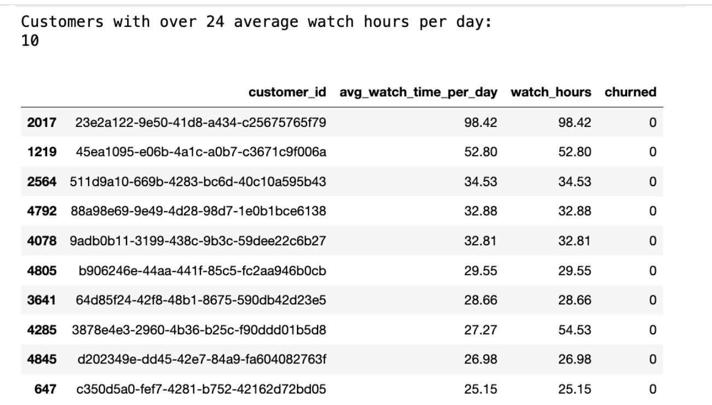
DATA PREPARATION • DATA INTEGRITY
A 24-hour rule protects the churn model
The data-quality check detects viewing-time values that are physically impossible and removes them before modeling.
VALID DAILY LIMIT
24
hours per day
10 records exceeded this limit
All were labeled retained, so keeping them would create an artificial high-engagement signal.
01
Detect
02
Validate
03
Remove
Flag values above 24 hours/day.
Confirm they are impossible observations.
Model the remaining 4,990 valid records.
Netflix Customer Retention and Growth Strategy
8

Slide 9
DATA PREPARATION • CLEANING COMPLETE
The dataset is clean and model-ready
Data cleaning preserved nearly all customer records while removing invalid engagement values that could bias the analysis.
ORIGINAL DATASET
CLEANED DATASET
5,000
4,990
REMOVE 10 INVALID
WATCH-TIME RECORDS
customer records
valid customer records
14 features
Values above 24 hours/day
are not physically possible.
14 features retained
VALIDATION CHECKS
✓
No missing values
✓
No duplicate records
✓
Valid engagement values
All required fields were present.
Each customer ID remained unique.
Average daily watch time ≤ 24 hours.
Netflix Customer Retention and Growth Strategy
9

Slide 10
DATA PREPARATION • FEATURE ENGINEERING
Turning raw metrics into customer signals
Four derived features make engagement, value, risk, and demographic patterns easier to analyze and use in churn modeling.
NEW ANALYTICAL FEATURES
RAW CUSTOMER DATA
1
watch_hours_per_profile
Watch hours
Monthly fee
Last login days
Age and profiles
Normalizes viewing by the number of profiles on an account.
2
monthly_fee_per_profile
Shows the monthly cost allocated to each account profile.
Individual fields are useful, but combining them creates a clearer picture of each subscriber.
3
inactivity_risk
Groups subscribers by recency of login activity for risk analysis.
ENGINEER
4
age_group
Derived measures support more useful segmentation and prediction.
Converts age into business-friendly demographic segments.
Netflix Customer Retention and Growth Strategy
10

Slide 11
DESCRIPTIVE ANALYTICS • OVERALL CHURN
Churn affects about half of subscribers
Descriptive analytics summarizes the current customer base before examining drivers or making predictions.
CUSTOMER OUTCOME SPLIT
OVERALL CHURN RATE
50.4%
Churned
2,515 • 50.4%
2,515 of 4,990 subscribers churned
Retained
2,475 • 49.6%
The baseline churn rate used for the rest of the analysis.
The customer base is nearly evenly split between churned and retained subscribers.
Netflix Customer Retention and Growth Strategy
11

Slide 12
DESCRIPTIVE ANALYTICS • SUBSCRIPTION PLANS
Basic plan has the highest churn rate
Plan-level summaries show how customer outcomes, price, and engagement differ across the current subscription base.
CHURN RATE BY PLAN
Basic
PLAN SUMMARY
62.0%
Plan
Customers
Monthly fee
Avg. watch hours
Basic
1657
$8.99
11.46 hrs
Standard
45.5%
Standard
1643
$13.99
11.63 hrs
Premium
Premium
1690
$17.99
11.67 hrs
43.8%
Basic is the largest churn concern despite similar average watch hours across plans.
Netflix Customer Retention and Growth Strategy
12

Slide 13
DESCRIPTIVE ANALYTICS • HIGH-VALUE CUSTOMERS
A snapshot of the high-value customer segment
The most common attributes within retained, high-value subscribers provide a descriptive starting point for acquisition targeting.
HIGH-VALUE CUSTOMER
AGE GROUP
REGION
18–29
28.2%
Africa
20.3%
Profile
snapshot
share of high-value customers
share of high-value customers
Most common observed characteristics—not a prediction of future sign-ups.
DEVICE
FAVORITE GENRE
Desktop
21.8%
Romance
16.3%
share of high-value customers
share of high-value customers
Descriptive takeaway
Use these attributes to inform audience hypotheses, then validate campaign performance with future acquisition data.
Netflix Customer Retention and Growth Strategy
13

Slide 14
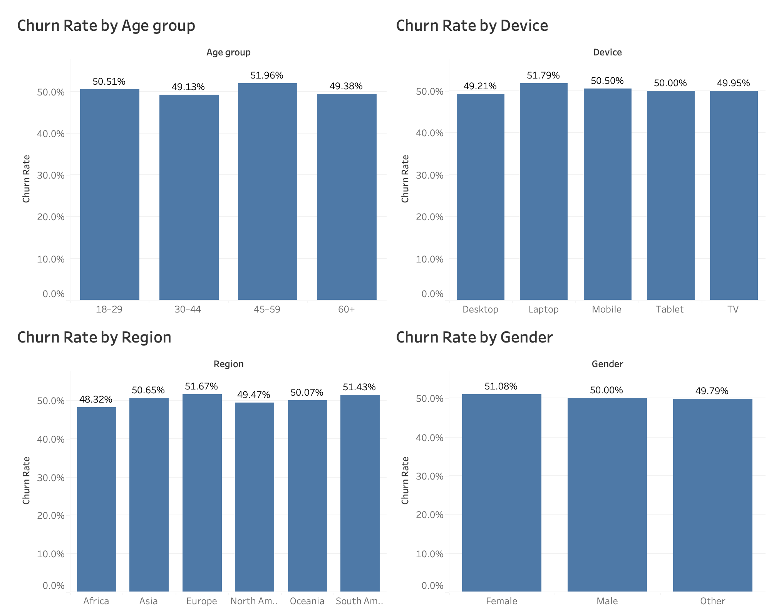
DIAGNOSTIC ANALYTICS • DEMOGRAPHIC PATTERNS
Demographics show only small differences in churn
Age group, device, region, and gender all remain close to the overall 50.4% churn baseline.
DIAGNOSTIC TAKEAWAY
48–52%
Churn rates vary by only a few percentage points across demographic groups.
Observed pattern, not causation
Netflix Customer Retention and Growth Strategy
14

Slide 15
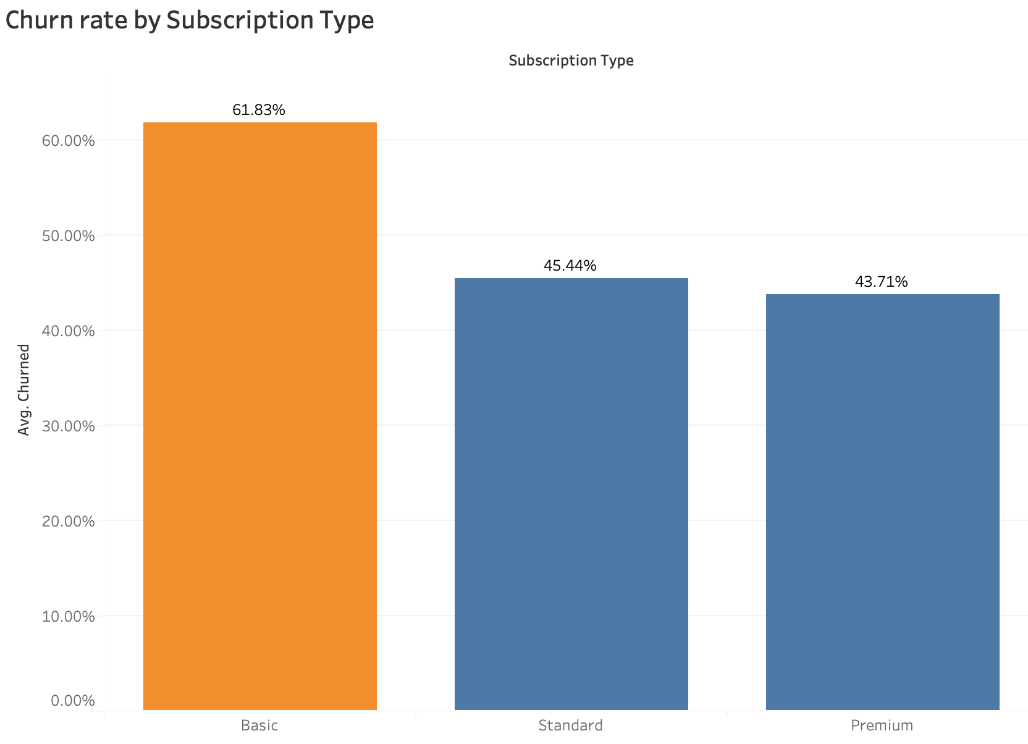
DIAGNOSTIC ANALYTICS • SUBSCRIPTION RISK
The Basic plan is associated with elevated churn
The gap between Basic and higher-tier plans is large enough to prioritize plan-specific retention investigation.
BASIC VS. PREMIUM
+18.1 pts
Basic churn is 61.83%, compared with 43.71% for Premium subscribers.
Potential focus: Basic-plan retention offers
Netflix Customer Retention and Growth Strategy
15

Slide 16
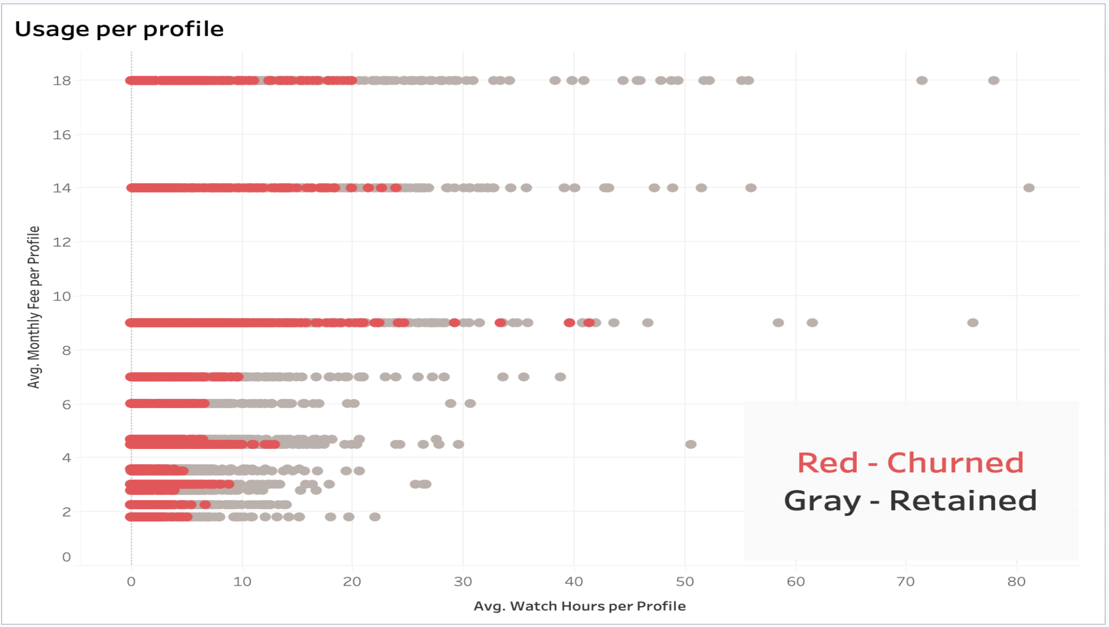
DIAGNOSTIC ANALYTICS • ENGAGEMENT INTENSITY
Lower usage per profile is associated with churn
The Tableau scatter plot compares watch hours per profile with monthly fee per profile for churned and retained customers.
Churned points cluster more heavily at lower viewing levels, supporting engagement-based retention actions.
Netflix Customer Retention and Growth Strategy
16

Slide 17
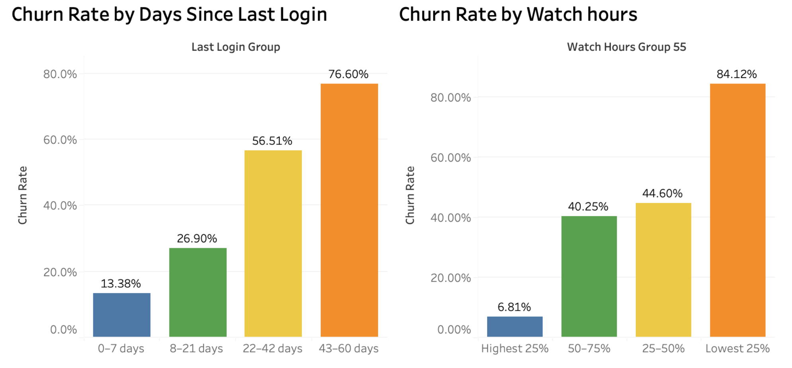
DIAGNOSTIC ANALYTICS • RECENCY & VIEWING BEHAVIOR
Inactivity and low viewing are the clearest churn signals
Churn rises as days since last login increase and as overall watch hours decrease.
RISK ESCALATES
76.6%
Churn among customers inactive for 43–60 days.
Lowest watch-hour group: 84.12% churn
Netflix Customer Retention and Growth Strategy
17

Slide 18
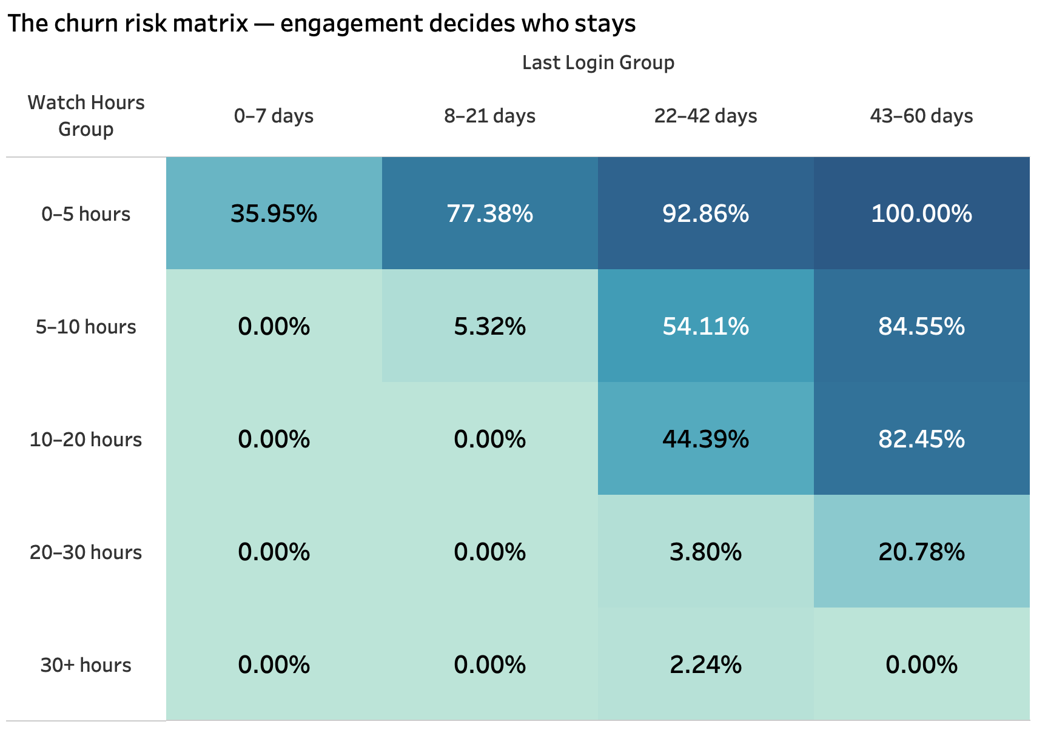
DIAGNOSTIC ANALYTICS • COMBINED RISK PATTERN
Low viewing and long inactivity compound churn risk
The heatmap shows that the highest observed churn rates occur when low engagement is paired with a long period since last login.
HIGHEST CELL
100%
Observed churn for 0–5 hours watched and 43–60 days since login.
Use this combination to prioritize outreach
Netflix Customer Retention and Growth Strategy
18

Slide 19
PREDICTIVE ANALYTICS
TRAIN / TEST SPLIT
From churn patterns
to churn-risk scores
A balanced 80 / 20 evaluation
80%
20%
We train models on historical customer behavior, then test how well they identify subscribers likely to churn.
TRAIN
TEST
3,992
records
998
records
MODEL OBJECTIVE
Predict the probability
that a current subscriber
will churn.
50.4% CHURN RATE
Preserved in both training and test sets
Next: compare model performance and score customer risk.
Netflix Customer Retention and Growth Strategy
19

Slide 20
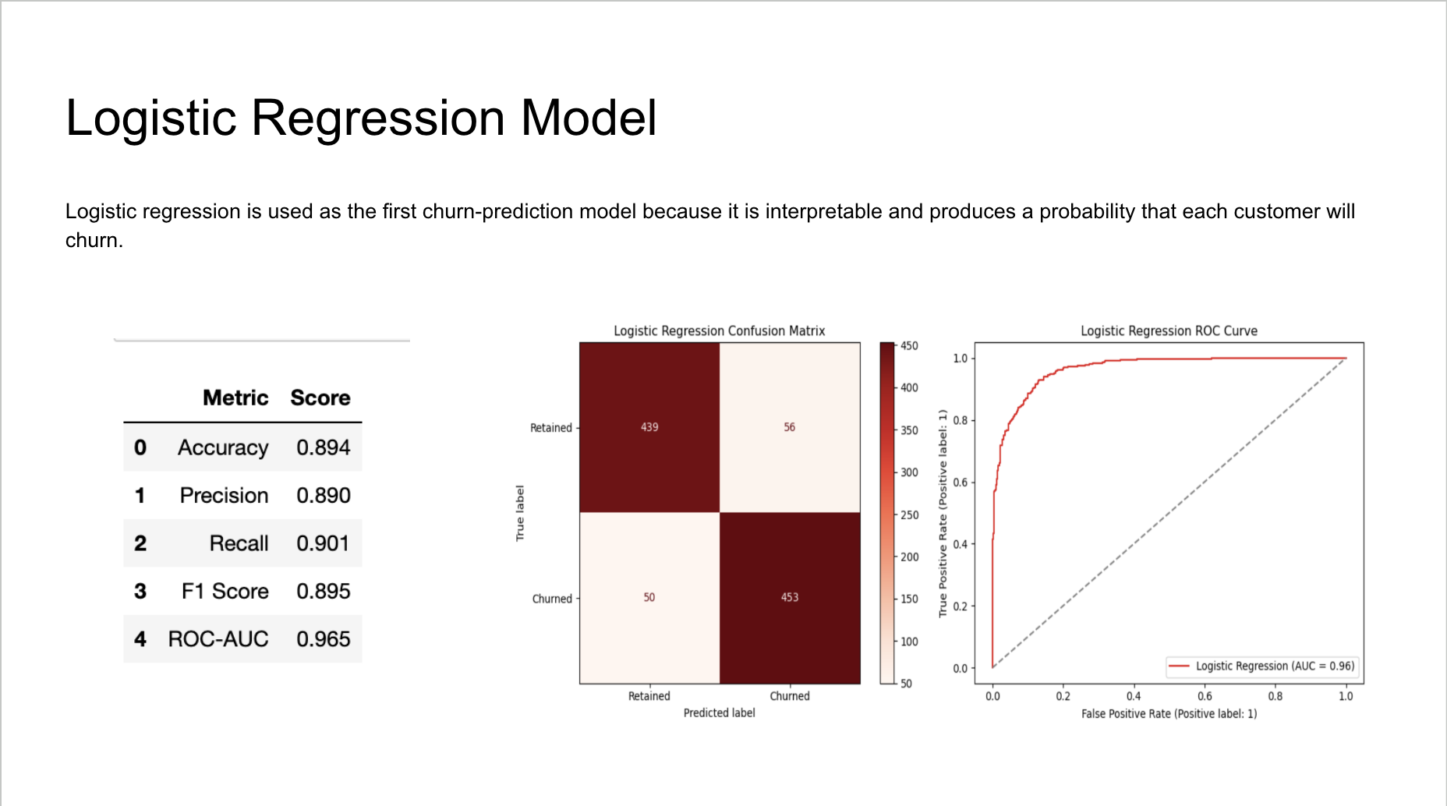
PREDICTIVE ANALYTICS | MODEL 1
Logistic regression test results
The baseline model identifies churn risk with strong accuracy, recall, and discrimination.
COMPLETE TEST-SET OUTPUT
MODEL READOUT
0.965
ROC–AUC
89.4%
90.1%
Accuracy
Recall
INTERPRETABLE BASELINE
Used to benchmark
the final Random
Forest model.
Next: compare this baseline with Random Forest performance.
Netflix Customer Retention and Growth Strategy
20

Slide 21
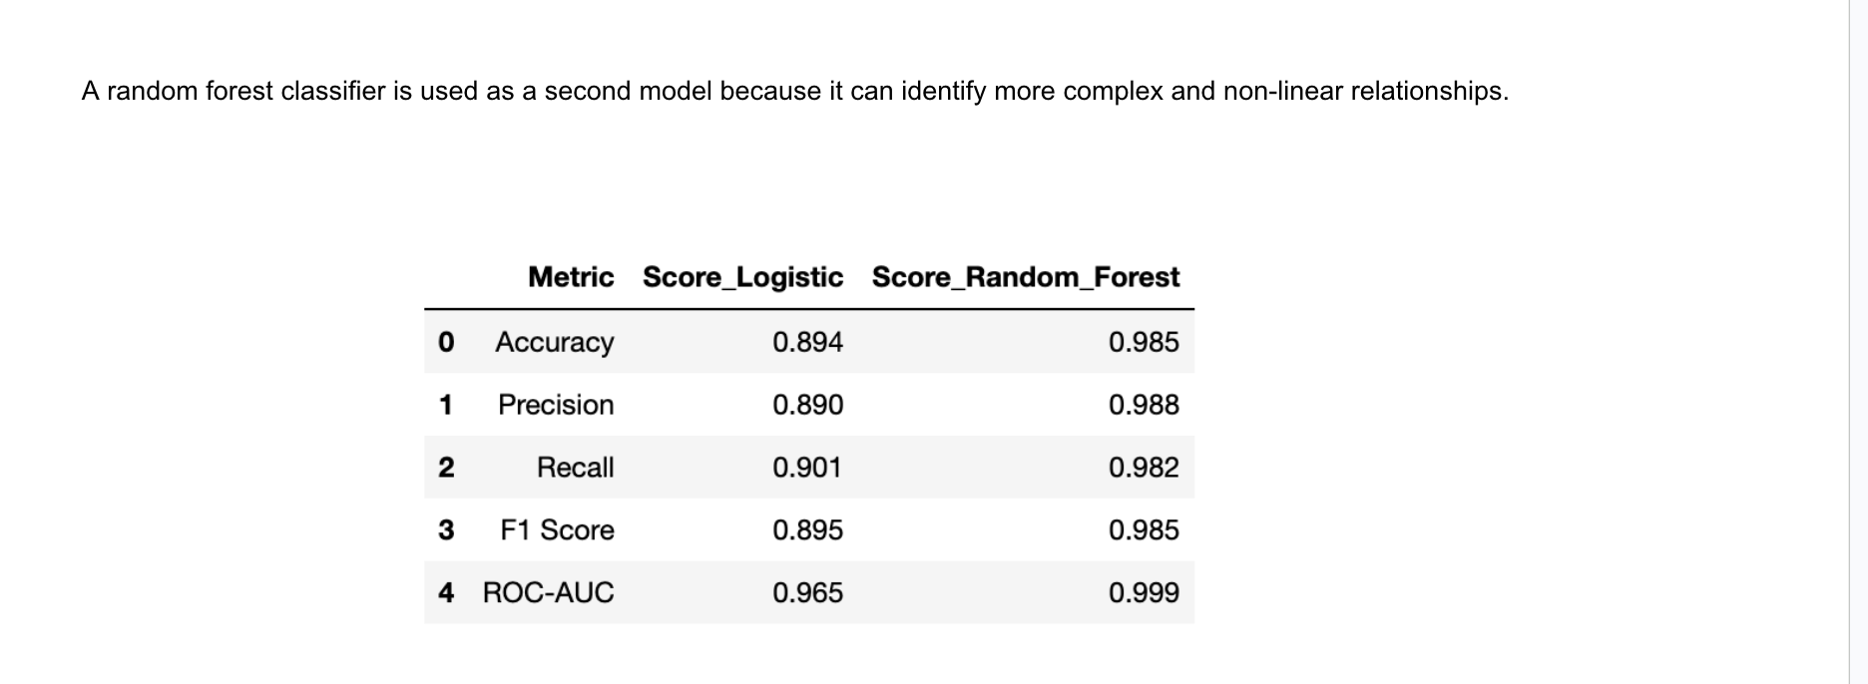
PREDICTIVE ANALYTICS | MODEL COMPARISON
MODEL SELECTION
Random Forest is the
preferred churn model
Best on all
5 metrics
Chosen for churn-risk scoring
Its ability to capture complex, non-linear behavior improves performance across every test-set metric.
0.999
98.5%
TEST-SET SCORECARD
ROC–AUC
Accuracy
Side-by-side performance comparison
+9.1 PTS
higher accuracy
than logistic
0.985 vs. 0.894
Takeaway: Random Forest provides the strongest foundation for prioritizing retention outreach.
Netflix Customer Retention and Growth Strategy
21

Slide 22
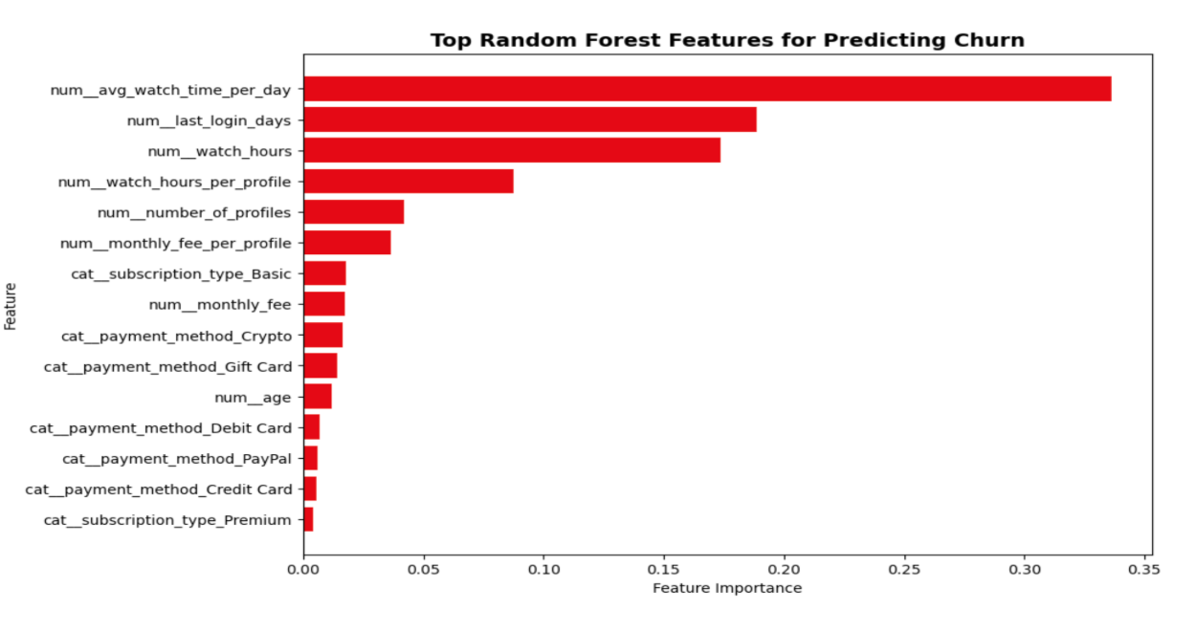
PREDICTIVE ANALYTICS | FINAL MODEL
Random Forest becomes
the final churn model
SELECTED MODEL
Random
Forest
It outperformed logistic regression across every evaluation measure and captures the behavior patterns that matter most for churn.
Best model across all test-set metrics
WHAT THE MODEL LEARNED
98.2%
Feature importance ranks the behaviors most useful for predicting churn
RECALL
Identified most customers
who actually churned.
TOP CHURN SIGNALS
1. Average watch time per day
2. Days since last login
3. Total watch hours
Takeaway: Churn risk is driven primarily by engagement and recency signals.
Netflix Customer Retention and Growth Strategy
22

Slide 23
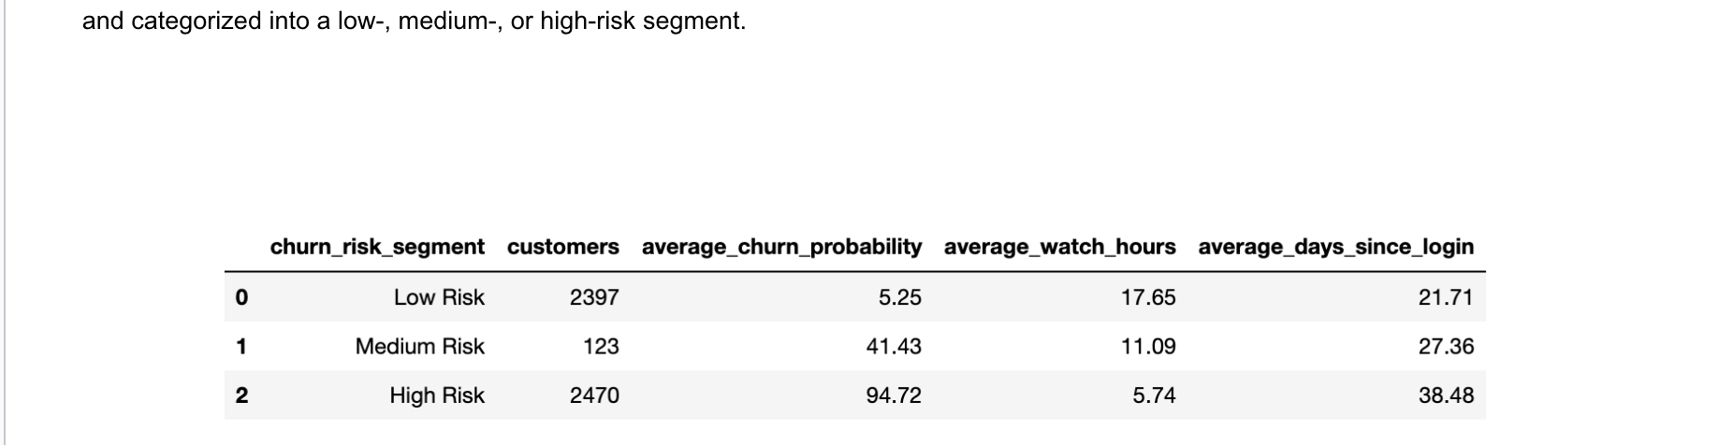
PREDICTIVE ANALYTICS | RISK SCORING
From model output
to customer action
LOW RISK
2,397
5.25% average churn probability
The selected Random Forest model assigns each subscriber a churn probability and turns that score into an actionable risk segment.
MEDIUM RISK
123 customers
FINAL CHURN-RISK SEGMENTATION
41.43% average churn probability
HIGH RISK
2,470
94.72% average churn probability
Priority audience for retention action
Next: use these scores to target retention, upgrade, and acquisition recommendations.
Netflix Customer Retention and Growth Strategy
23

Slide 24
PRESCRIPTIVE ANALYTICS
A decision framework
for acting on data
From insight
to decision.
Rather than stopping at predictions, this section translates evidence into deliberate, measurable choices.
Prescriptive analytics answers the question:
Use evidence
1
“What should
we do next?”
Start with the findings and model outputs already developed.
Choose an action
2
Match the decision to the business objective and customer need.
It closes the loop between analysis and business action.
Measure the outcome
3
Track results, learn, and refine the next decision cycle.
The following recommendations apply this framework to Netflix’s customer-growth decisions.
Netflix Customer Retention and Growth Strategy
24

Slide 25
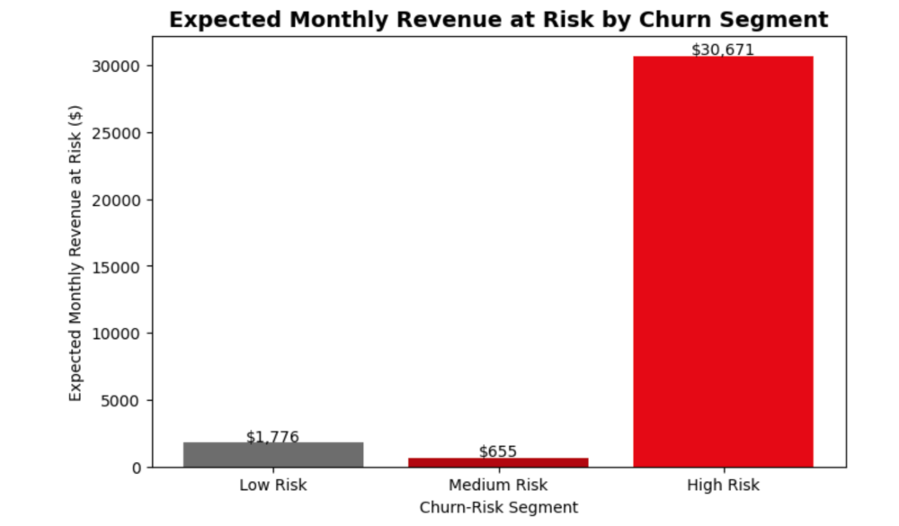
PRESCRIPTIVE ANALYTICS | RETENTION
Prioritize the revenue
most at risk
HIGH-RISK SEGMENT
$30,671
Churn probability and monthly subscription fees combine to estimate expected monthly revenue at risk.
expected monthly revenue
at risk
EXPECTED MONTHLY REVENUE AT RISK
RETENTION PRIORITY
Start with the
high-risk segment.
This group represents the largest concentration of estimated revenue at risk.
Recommendation: direct retention outreach to high-risk subscribers first.
Netflix Customer Retention and Growth Strategy
25

Slide 26
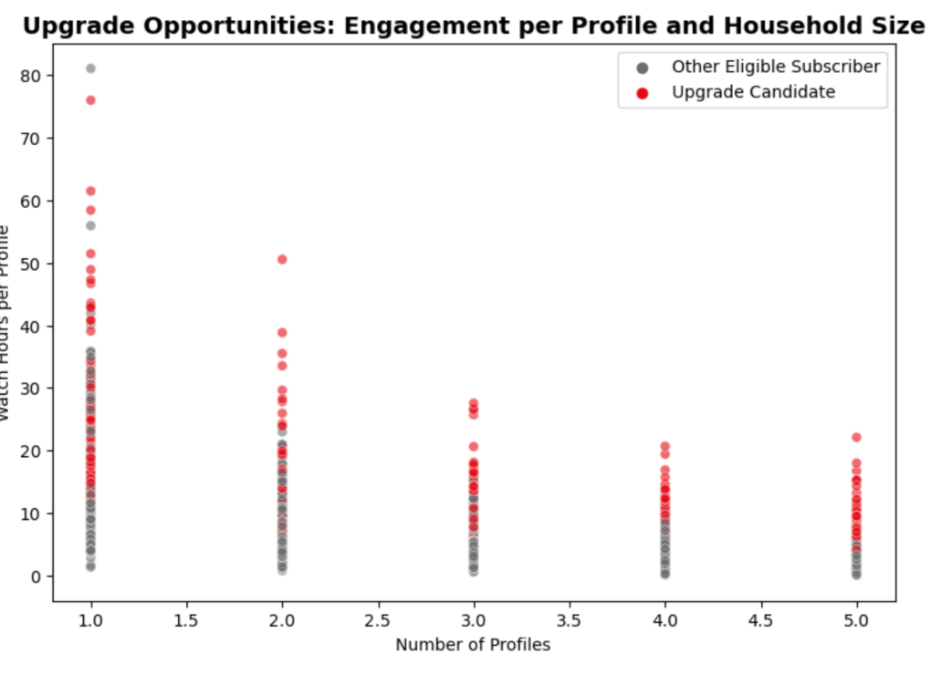
PRESCRIPTIVE ANALYTICS | UPGRADE
Identify the strongest
upgrade opportunities
UPGRADE CANDIDATES
ENGAGED
Engagement per profile and household size help identify current subscribers who may be ready for more value.
High watch hours per profile signal stronger potential for a plan upgrade.
UPGRADE CANDIDATE PATTERNS
UPGRADE PRIORITY
Offer more value
to engaged users
Focus upgrade messages on current subscribers with strong engagement and multiple profiles.
Recommendation: personalize upgrade offers for engaged subscribers with multiple profiles.
Netflix Customer Retention and Growth Strategy
26

Slide 27
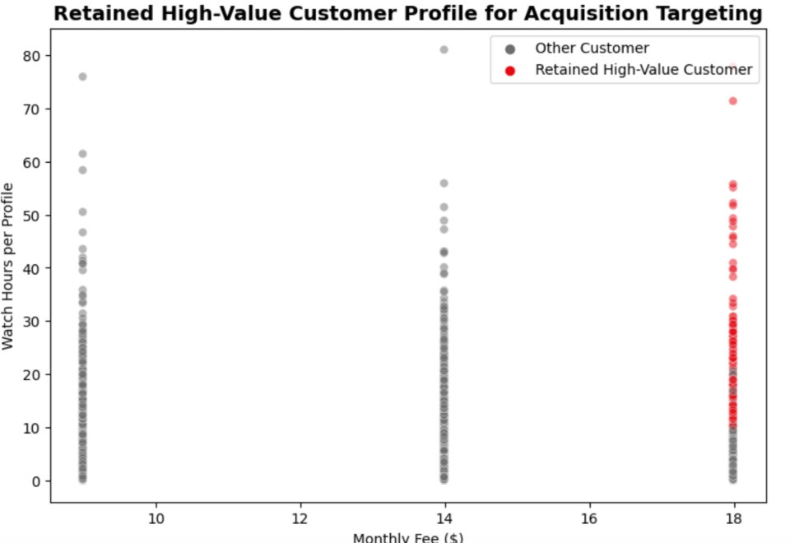
PRESCRIPTIVE ANALYTICS | ACQUISITION
Attract the right
customers
TARGET PROFILE
PREMIUM
Use the retained high-value customer profile to guide future acquisition targeting.
Retained high-value customers cluster in the highest monthly-fee tier.
RETAINED HIGH-VALUE CUSTOMER PROFILE
ACQUISITION PRIORITY
Find similar
customers.
Use high-value customer attributes to inform audience targeting, creative, and channel selection.
Recommendation: use retained high-value profiles to improve acquisition targeting.
Netflix Customer Retention and Growth Strategy
27

Slide 28
DEPLOYMENT | PUTTING THE STRATEGY TO WORK
From insight to
customer action
Operationalize churn-risk scores by assigning customers to the right action and reviewing results each month.
01
02
03
MONITOR
Score customers
Activate outreach
Measure & refine
4 core
KPIs
Refresh churn-risk scores and group subscribers by low, medium, and high risk.
Match each group to a retention, upgrade, or acquisition action.
Review results monthly and improve targeting, offers, and messages.
Churn
Conversion
Revenue retained
Campaign response
Deployment goal
Turn model insights into measurable customer actions—and continuously improve them with results.
Netflix Customer Retention and Growth Strategy
28

Slide 29
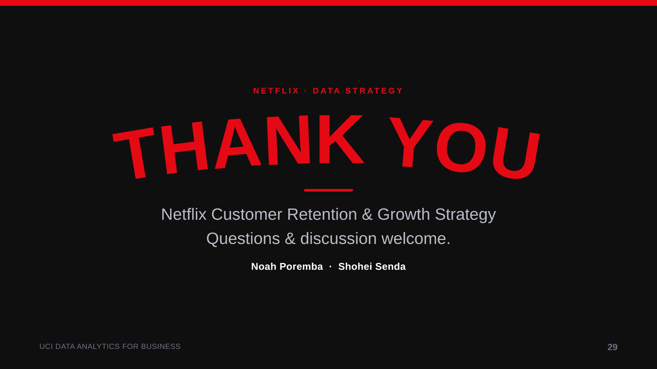
AI Disclosure: AI was used to help brainstorm ideas; all final analysis, content, and presentation materials were created and reviewed by our team.

